Slide 1
Deep Fakes
23.06.2022
Tassilo Henninger

Slide 2
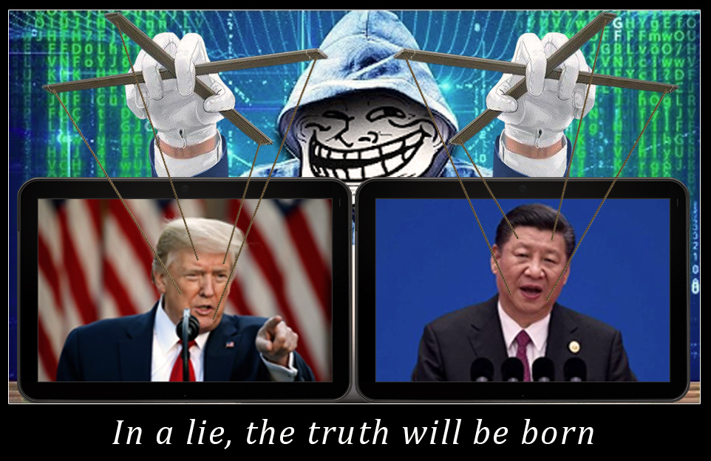
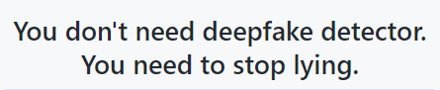
What are deep fakes?
synthetic media in which a person in an existing image or video is replaced with someone else's likeness
https://www.youtube.com/watch?v=Ho9h0ouemWQ
https://www.youtube.com/watch?v=cQ54GDm1eL0

Slide 3
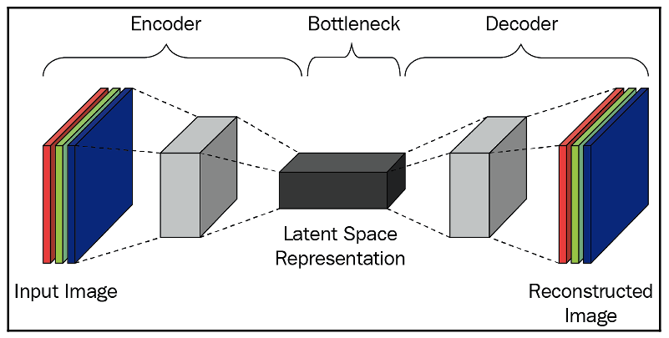
Autoencoder
Notes:
From the preceding image, we can see that the input image is represented as a block in the bottleneck layer that is used to reconstruct the image. The image goes through multiple convolutions to fetch the bottleneck representation (which is the Bottleneck layer that is obtained by passing through Encoder ) and the bottleneck representation is up-scaled to fetch the original image (the o riginal image is reconstructed by passing through the decoder ).
low-dimensional latent space
The latent representation contains key features about their facial features and body posture
A popular upgrade to this architecture attaches a generative adversarial network to the decoder.^{[61]} A GAN trains a generator, in this case the decoder, and a discriminator in an adversarial relationship.^{[61]} The generator creates new images from the latent representation of the source material, while the discriminator attempts to determine whether or not the image is generated.^{[61]} This causes the generator to create images that mimic reality extremely well as any defects would be caught by the discriminator.^{[62]} Both algorithms improve constantly in a zero sum game.^{[61]} This makes deepfakes difficult to combat as they are constantly evolving; any time a defect is determined, it can be corrected

Slide 4
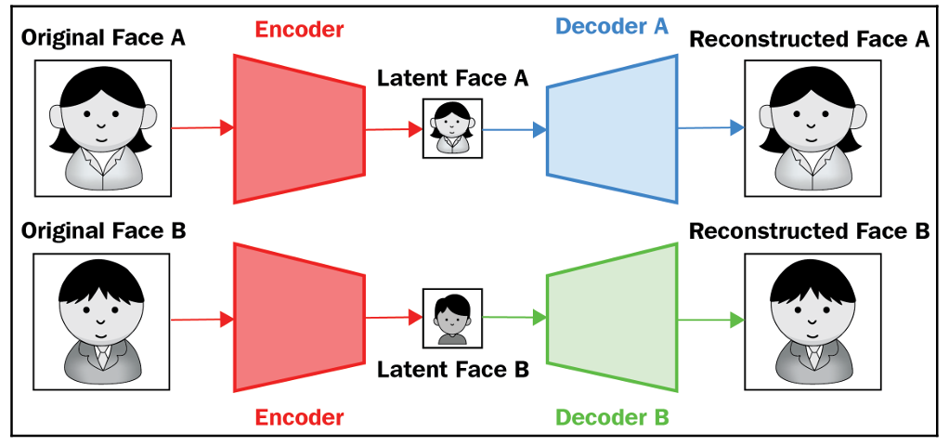
Autoencoder

Slide 5
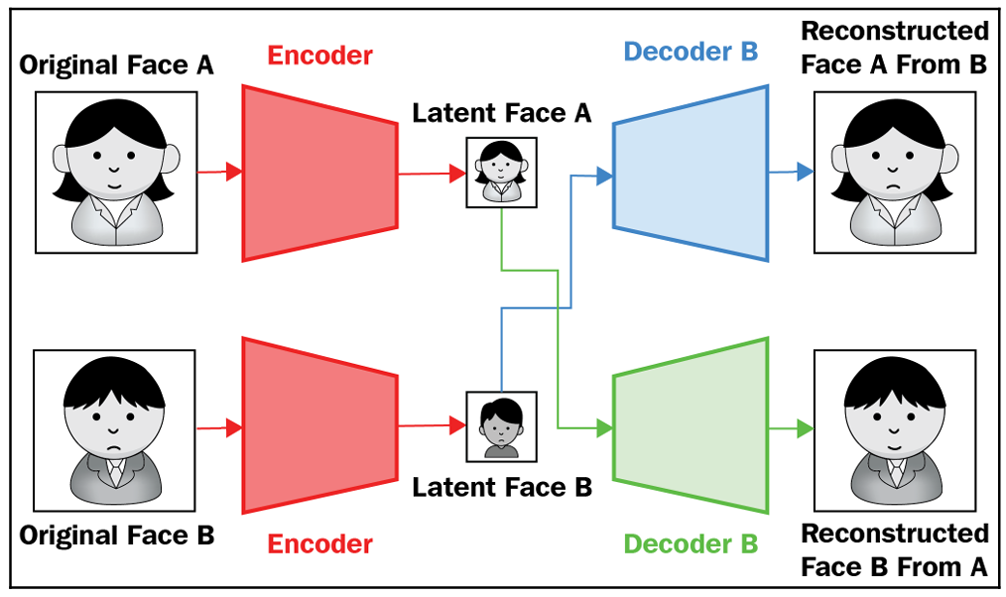

Autoencoder

Slide 6
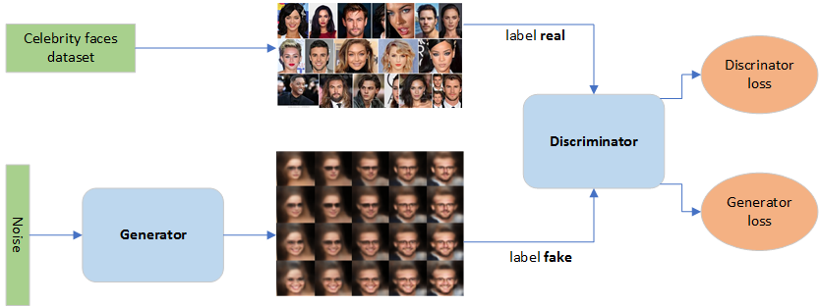
GAN - Generative Adversarial Networks
https://towardsdatascience.com/generative-adversarial-network-gan-for-dummies-a-step-by-step-tutorial-fdefff170391

Slide 7


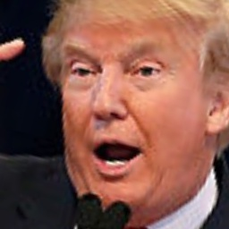
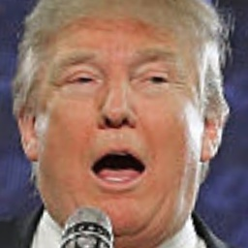
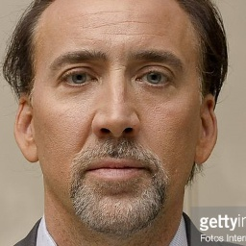
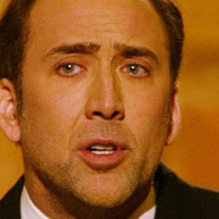
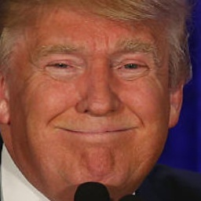
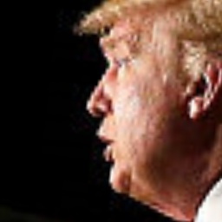
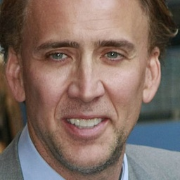
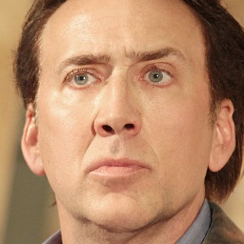


Face Data
n=68
n=68
n=68

Slide 8
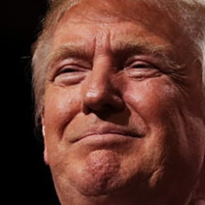
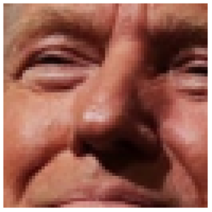
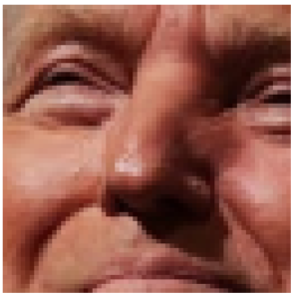
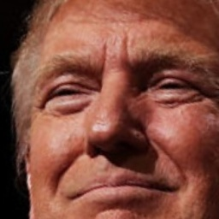
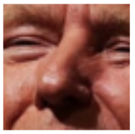
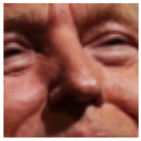
Face Preprocessing
1) Resize all pictures to 256*256
2) Crop faces
3) Create training wraped faces 64*64:
rotation_range
zoom_range
shift_range
random_flip
random_warp
Notes:
Define the face cascade, which draws a bounding box around the face in an image. (OpenCV Utilities)
dataloader : distorte images (wraped version)
This is an augmentation function for warping (distorting) faces. We are giving distorted faces as input to the autoencoder and trying to predict regular faces. The advantage of warping is that not only does it increase our training data size but also acts as a regularizer to the network, which is forced to understand key facial features despite being given a distorted face.

Slide 9
Architecture
64*64, f3
64*64, f64
32*32, f128
Conv2D
Activation: Sigmoid
16*16, f256
Decoder
8*8, f512
4*4, f1024 (reshape)
Input Image
…
Linear
…
16384
…
1024
Bottleneck
ConvTranspose2D
pixels * pixels
f: filters
Activation: Leaky Relu
…
16384 (flatten)
64*64, f3
4*4, f1024
Conv2D
pixels * pixels
f: filters
kernel size = 5
stride = 2
padding =2
Activation: Leaky Relu
Encoder
8*8, f512
16*16, f256
32*32, f128
https://github.com/shaoanlu/faceswap-GAN

Slide 10

ConvTranspose2D
Notes:
We will zero pad the original 3×3 image, and place the paddings on all sides of the pixels. These are represented as the white squares. This way we went from the original image to a 7×7 image that is zero padded image.
Then, we will have a 3×3 convolution filter (kernel) that we will use to produce our output. Note that this filter is shown as a grey square (3×3) that is moving across the image.
By moving the kernel, we can see that at that particular position, it will generate one output element (pixel) of the output feature map on the top (5×5).

Slide 11
Architecture
64*64, f3
64*64, f64
32*32, f128
Conv2D
Activation: Sigmoid
16*16, f256
Decoder
8*8, f512
4*4, f1024 (reshape)
Input Image
…
Linear
…
16384
…
1024
Bottleneck
ConvTranspose2D
pixels * pixels
f: filters
Activation: Leaky Relu
…
16384 (flatten)
64*64, f3
4*4, f1024
Conv2D
pixels * pixels
f: filters
kernel size = 5
stride = 2
padding =2
Activation: Leaky Relu
Encoder
8*8, f512
16*16, f256
32*32, f128
https://github.com/shaoanlu/faceswap-GAN

Slide 12
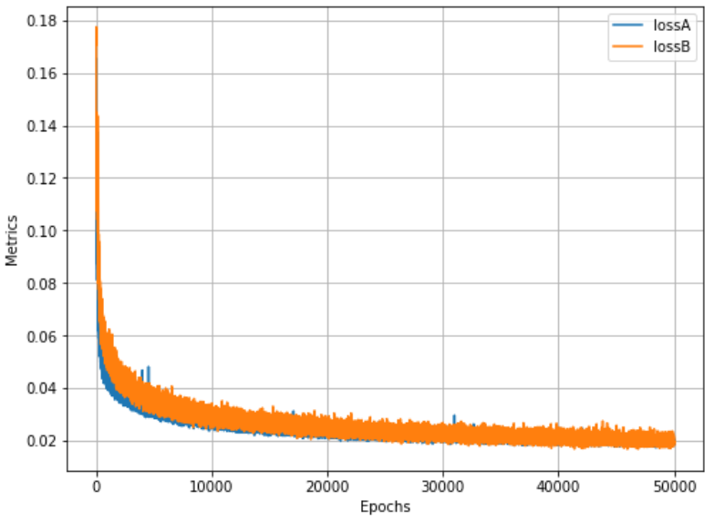
Training
L1Loss() → MAE

Slide 13
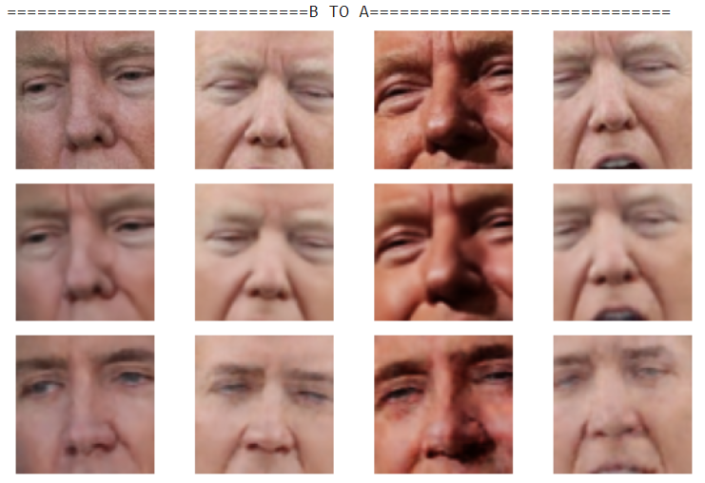
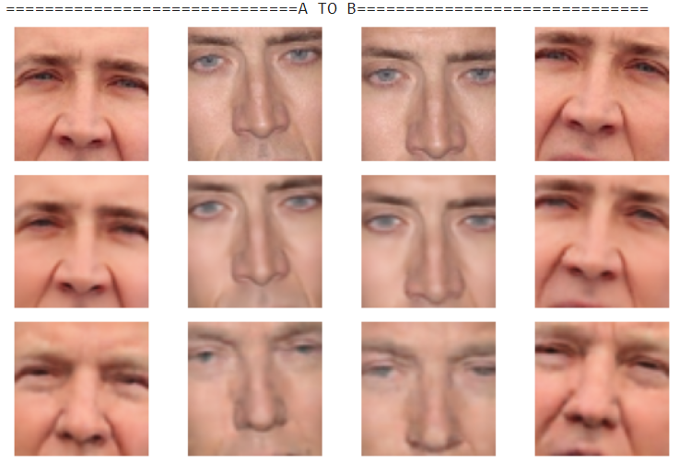
Results: Trump - Cage
Original
Recon-struction
Swap

Slide 14
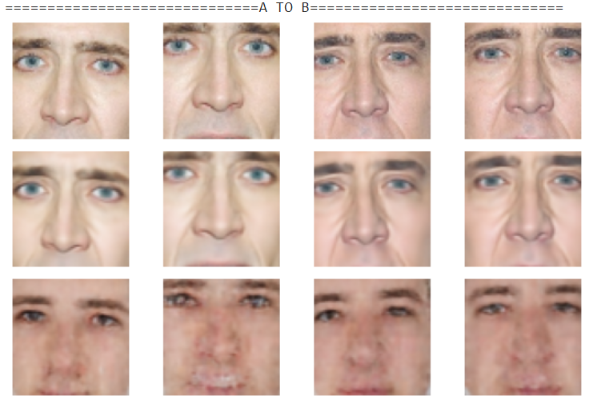
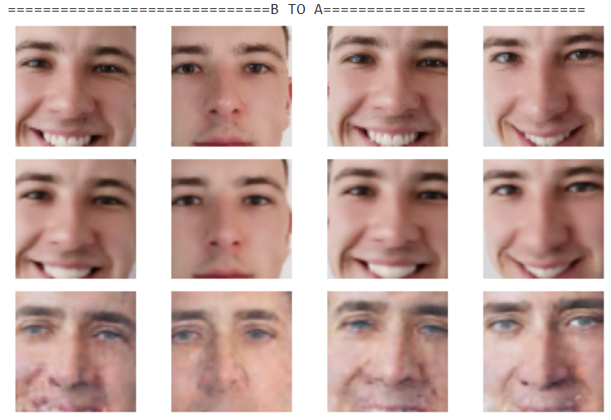
Results: Cage -Tassilo
Original
Recon-struction
Swap

Slide 15
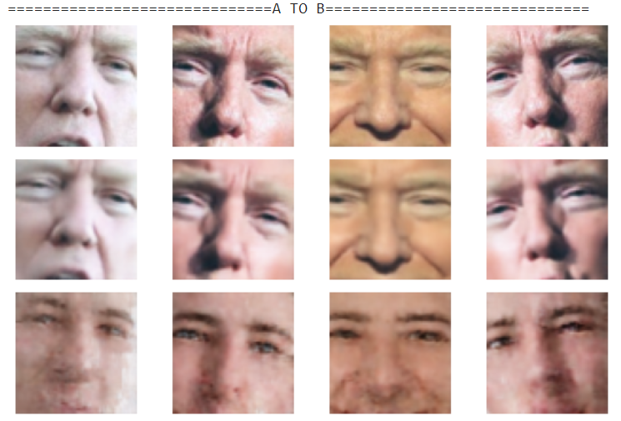
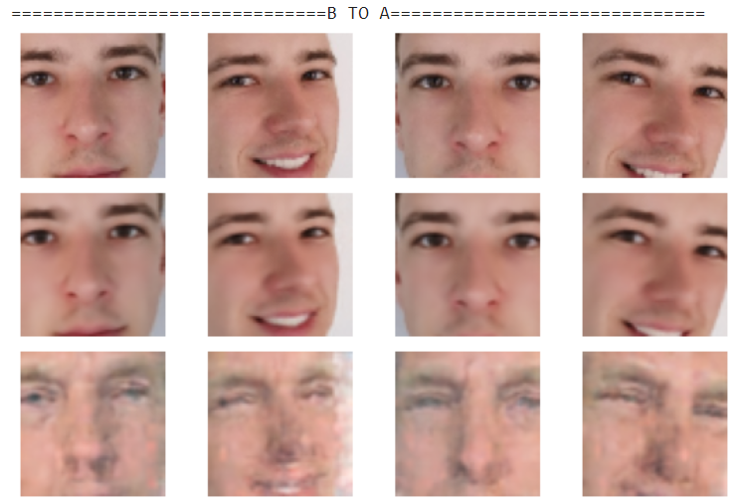
Results: Trump - Tassilo
Original
Recon-struction
Swap

Slide 16
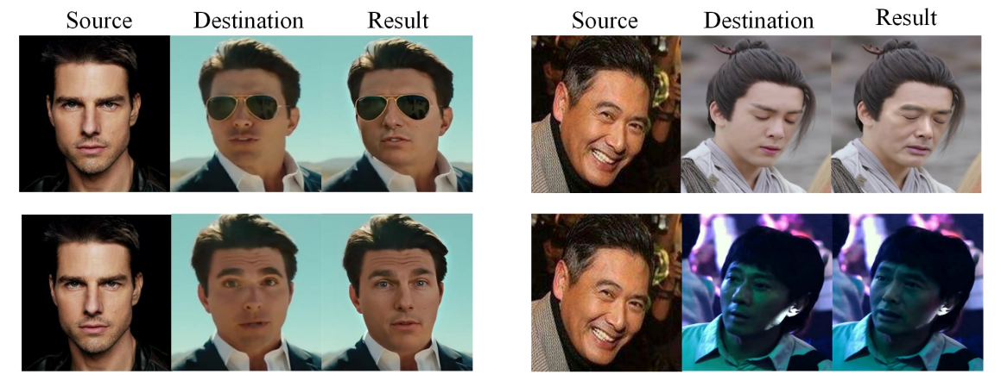
Deep Fake Lab
https://arxiv.org/pdf/2005.05535.pdf

Slide 17
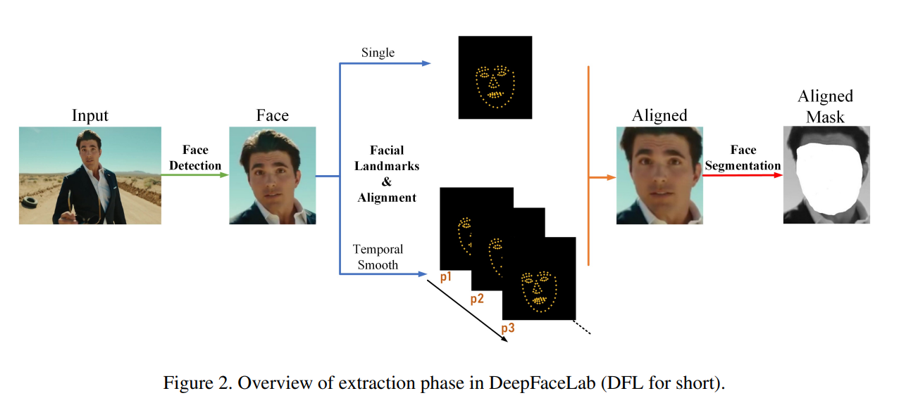
Deep Fake Lab - Extraction
https://arxiv.org/pdf/2005.05535.pdf

Slide 18
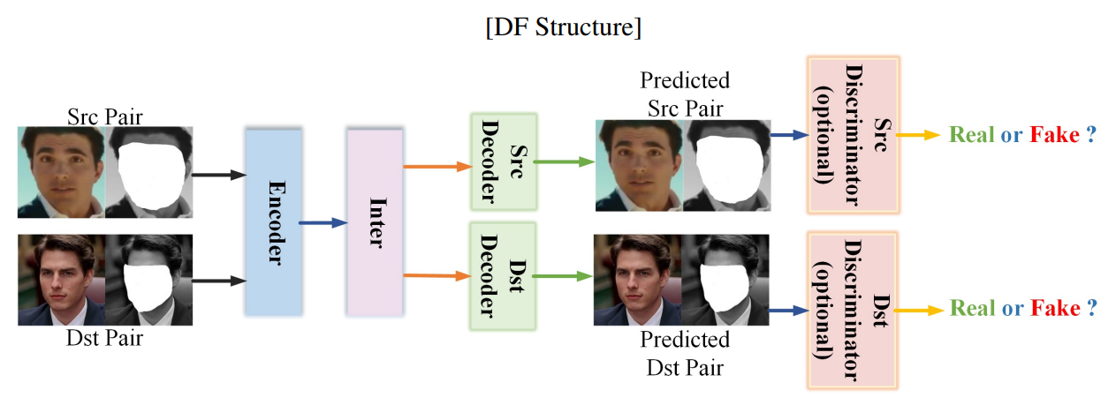
Deep Fake Lab - Training
https://arxiv.org/pdf/2005.05535.pdf

Slide 19
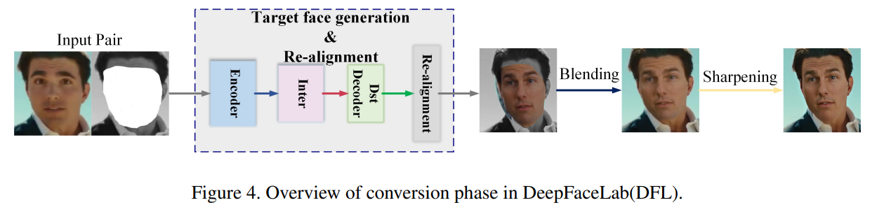
Deep Fake Lab - Conversion
https://arxiv.org/pdf/2005.05535.pdf

Slide 20
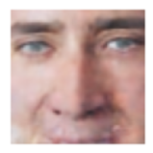
Any Questions?

